Slide 1
Audio Signal Analysis
105501016游澈

Slide 2


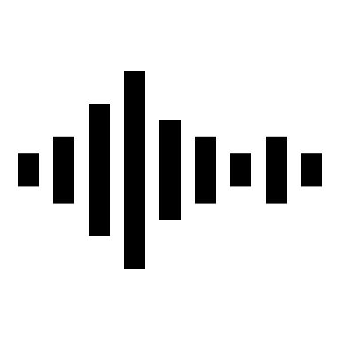
流程示意圖
Matlab Workspace

Slide 3
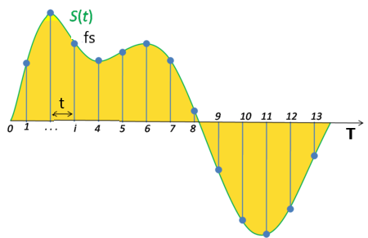
一、音訊匯入與準備
[x, fs] = audioread('sunday.wav')
X = x(:, 1);
N = length(X);
t = (0:N-1)/fs;

Slide 4
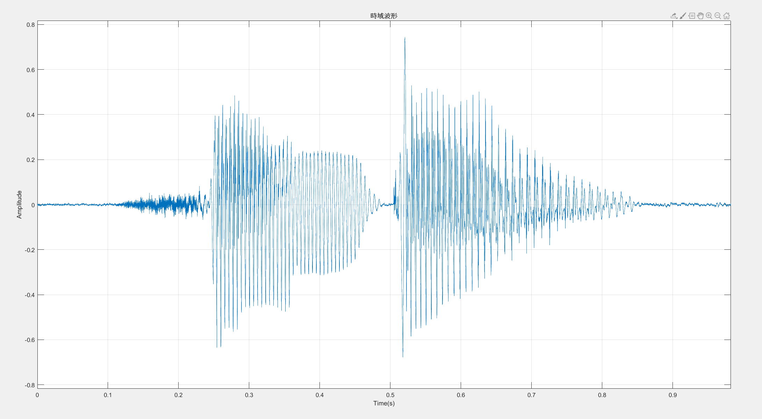
二、.wav 在時域波形

Slide 5
二、.wav 在時域波形
1.限制
xlim([0 max(t)])
ylim([-1.1*max(abs(X)) 1.1*max(abs(X))])
2.圖表設置
grid on
xlabel('Time, s')
ylabel('Amplitude')
title(‘時域波形')

Slide 6
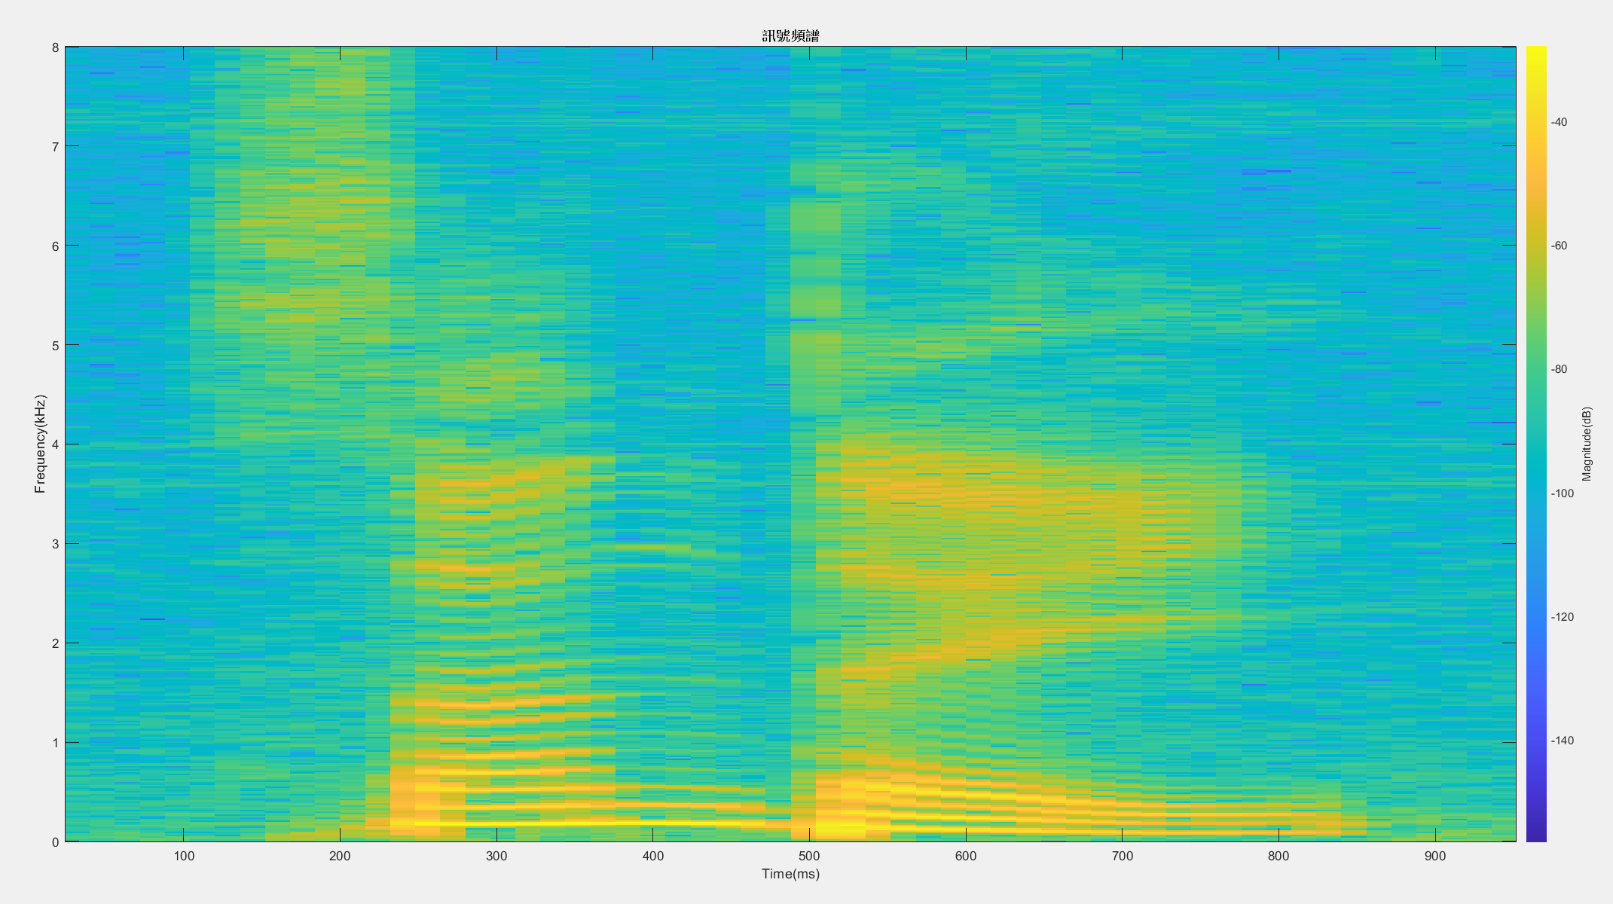
三、.wav頻譜圖

Slide 7
三、.wav頻譜圖
spectrogram(X, 1024, 768, [], fs, 'yaxis')
Signal
Overlap
Sampling Frequency
Sampling(Hanning Window)
DFT points

Slide 8
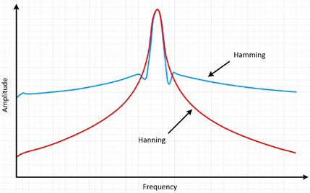
四、漢寧窗
Pictures are from National Instrument

Slide 9

四、漢寧窗
取漢寧窗
w = hann(N, 'periodic');
$$W\left(n\right)=0.5\left(1−\cos\left(\frac{2πn}{N}\right)\right), 0≤n≤N$$

Slide 10

四、強度對頻率圖
[Xx, f] = periodogram(X, w, N, fs, 'power’);
$Xx=10\log_{10}{\frac{Xx}{\sqrt{2}}}$
Amplitude
frequency

Slide 11
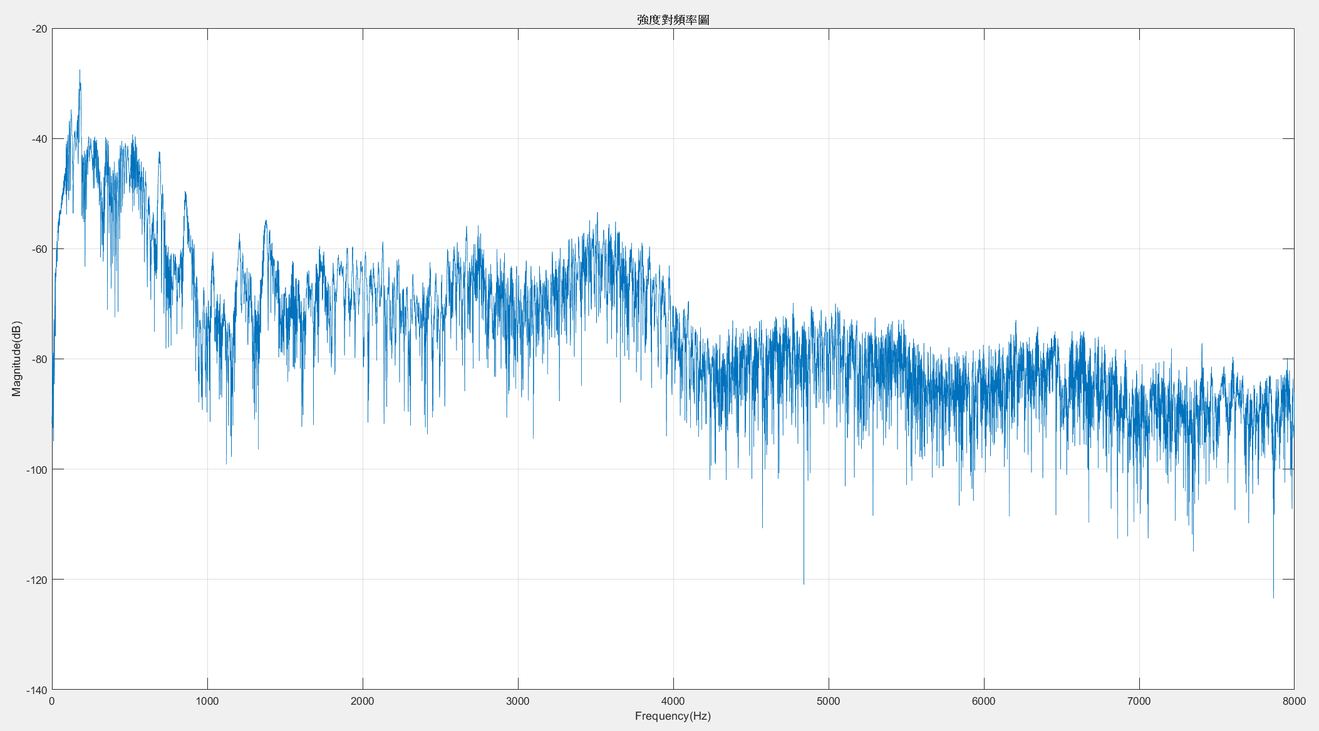
四、強度對頻率圖

Slide 12
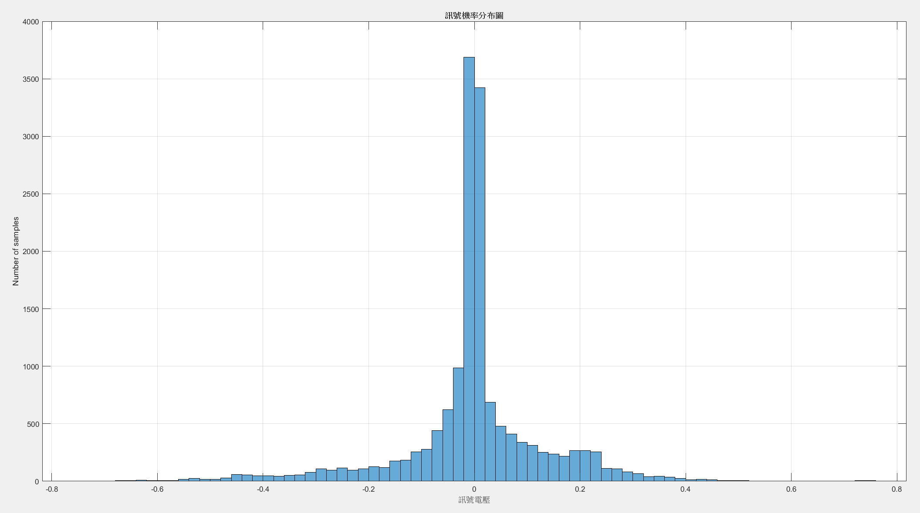
五、電壓Histogram
histogram(X)

Slide 13
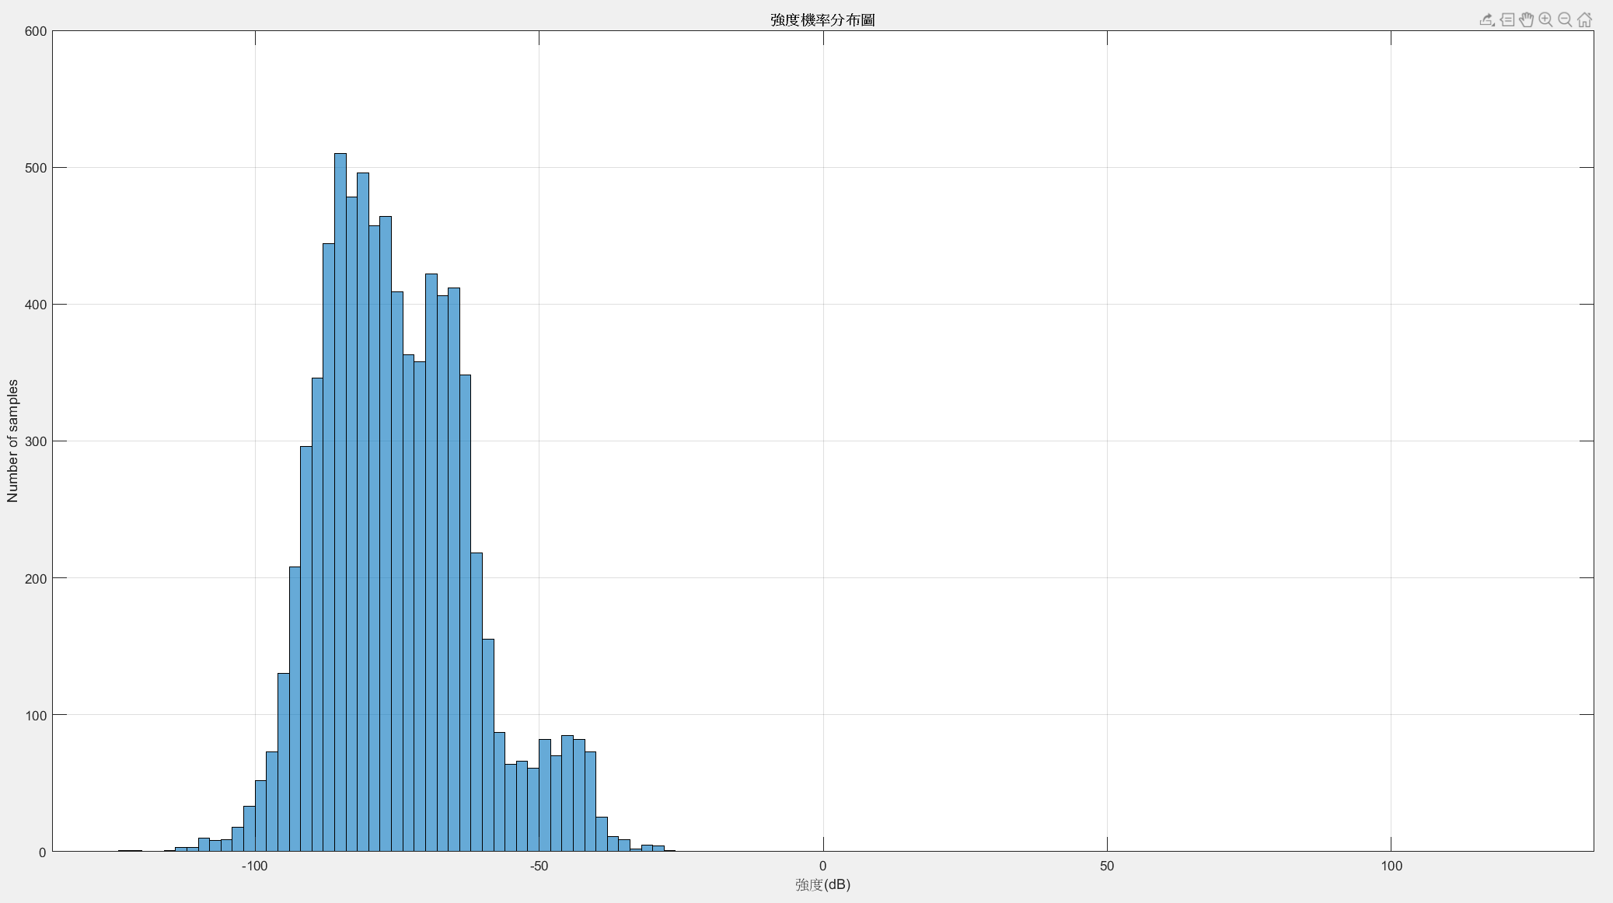
六、強度Histogram
histogram(Xx)

Slide 14
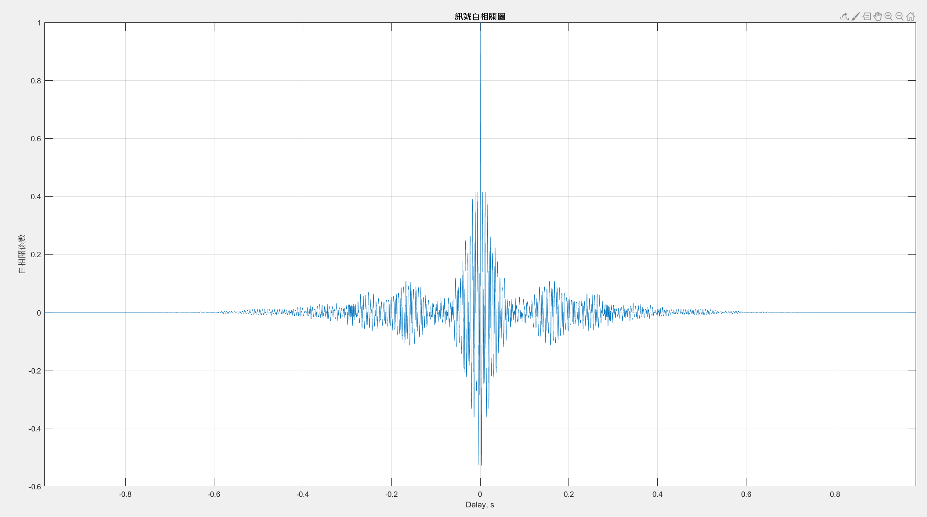
七、自相關函數

Slide 15
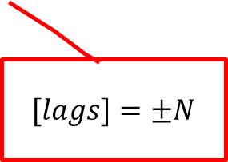
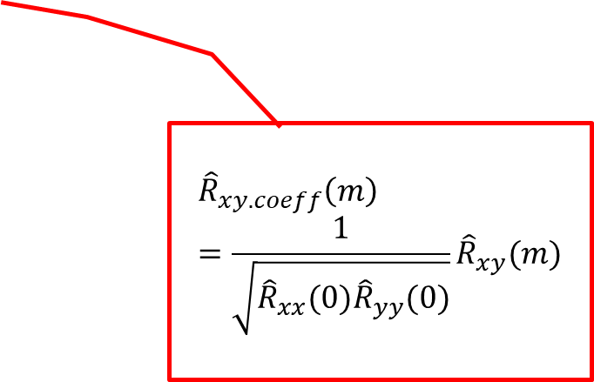
七、自相關函數
[R, lags] = xcorr(X, 'coeff’);
tc = lags/fs;
$$[lags]=±N$$
$${\hat{R}}_{xy.coeff}\left(m\right)=\frac{1}{\sqrt{{\hat{R}}_{xx}(0){\hat{R}}_{yy}(0)}}{\hat{R}}_{xy}(m)$$

Slide 16
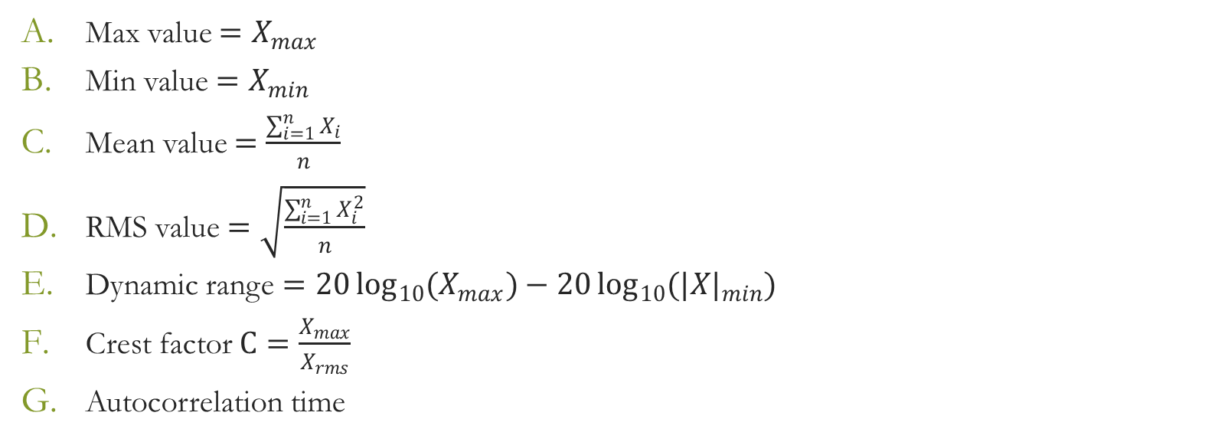
八、其餘的一些分析
Max value ${=X}_{max}$
Min value ${=X}_{min}$
Mean value $=\frac{\sum_{i=1}^{n}{X_{i}}}{n}$
RMS value$=\sqrt{\frac{\sum_{i=1}^{n}{X_{i}^{2}}}{n}}$
Dynamic range $=20\log_{10}{{(X}_{max})−20\log_{10}{{(|X|}_{min})}}$
Crest factor $C=\frac{X_{max}}{X_{rms}}$
Autocorrelation time

Slide 17
九、參考文獻
https://www.mathworks.com/help/signal/ref/spectrogram.html#d117e187856
https://www.mathworks.com/help/signal/ref/hann.html
https://en.wikipedia.org/wiki/Window_function
https://www.mathworks.com/help/signal/ref/periodogram.html
https://www.mathworks.com/help/matlab/ref/xcorr.html
https://zh.wikipedia.org/wiki/自相關函數
https://zh.wikipedia.org/wiki/峰質因數
Understanding FFTs and Windowing. Published by National Instrument.

